Slide 1
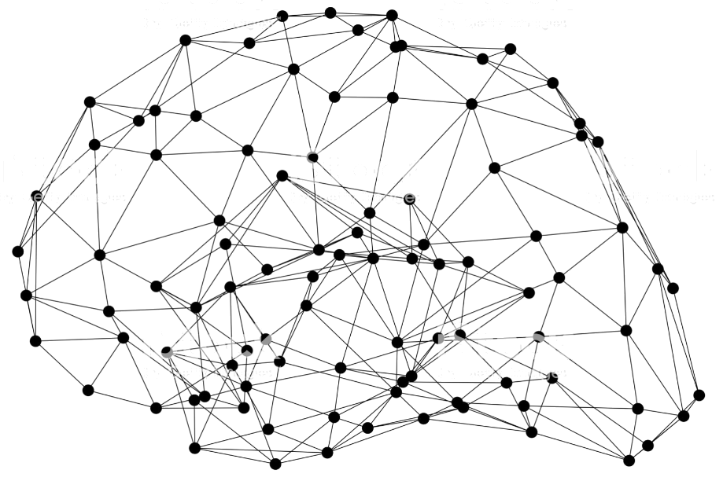
Computer Vision on AWS Jumpstart
Dylan Tong, AI/Machine Learning Partner Solutions Architect
Notes:
First call deck for CXO level introduction to Amazon AI.

Slide 2
Jumpstart Workshop Menu
Object Detection
TBD…

Slide 3
Object Detection Workshop

Slide 4
Reference Architectures

Slide 5
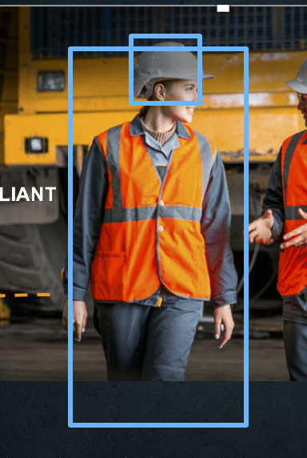
Cloud Inference on Streaming Video

Slide 7
Workshop Objectives and Agenda

Slide 8
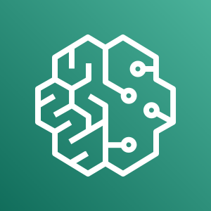

Select the Right Strategy
Object Detection,
Segmentation,
Classification…
Amazon SageMaker
“Bring Your Own Algorithm”
Scope of Use Cases
Amazon SageMaker
“Bring Your Own Script”
Amazon SageMaker
Algorithms
Amazon Rekognition
Time to Market
Fully managed APIs. No ML development required
Integrate any algorithm and benefit from automation.
Full control over running TensorFlow, PyTorch, MXNet, Sklearn… scripts.
No need for managing SageMaker compliant containers.
Full control over data sets, and hyperparameter tuning. No coding.

Slide 9

Right Tool for the Use Case
SEGMENTATION
CUSTOM OBJECT DETECTION
Amazon SageMaker
COMPLIANT
Amazon Rekognition
FACE
SEARCH
PEOPLE TRACKING
JOHN
DAVE

Slide 10
Amazon SageMaker
BRINGING MACHINE LEARNING TO ALL DEVELOPERS
Business Need as a ML Problem
Desired Business Outcome
Collect and prepare training data
Choose and optimize your ML algorithm
Set up and manage environments for training
Train and tune model
(trial and error)
Deploy model
in production
Scale and manage the production environment
SIMPLIFY THE END-TO-END MACHINE LEARNING PROCESS
Notes:
SageMaker is a managed service that takes a number of the required steps to build, train, tune, and deploy a ML model and makes it much easier for everyday developers and scientists.

Slide 11
Lab 1: Managing a high quality training set at scale using SageMaker GroundTruth
Business Need as a ML Problem
Desired Business Outcome
Collect and prepare training data
Choose and optimize your ML algorithm
Set up and manage environments for training
Train and tune model
(trial and error)
Deploy model
in production
Scale and manage the production environment
SIMPLIFY THE END-TO-END MACHINE LEARNING PROCESS

Slide 12
Lab 2: Train, tune and deploy a custom object detector (SSD) with zero coding.
Business Need as a ML Problem
Desired Business Outcome
Collect and prepare training data
Choose and optimize your ML algorithm
Set up and manage environments for training
Train and tune model
(trial and error)
Deploy model
in production
Scale and manage the production environment
SIMPLIFY THE END-TO-END MACHINE LEARNING PROCESS

Slide 13
Lab 3: “Bring Your Own Script:” train, tune and deploy a custom object detector (YOLOv3) on GluonCV (MXNet).
Business Need as a ML Problem
Desired Business Outcome
Collect and prepare training data
Choose and optimize your ML algorithm
Set up and manage environments for training
Train and tune model
(trial and error)
Deploy model
in production
Scale and manage the production environment
SIMPLIFY THE END-TO-END MACHINE LEARNING PROCESS

Slide 14

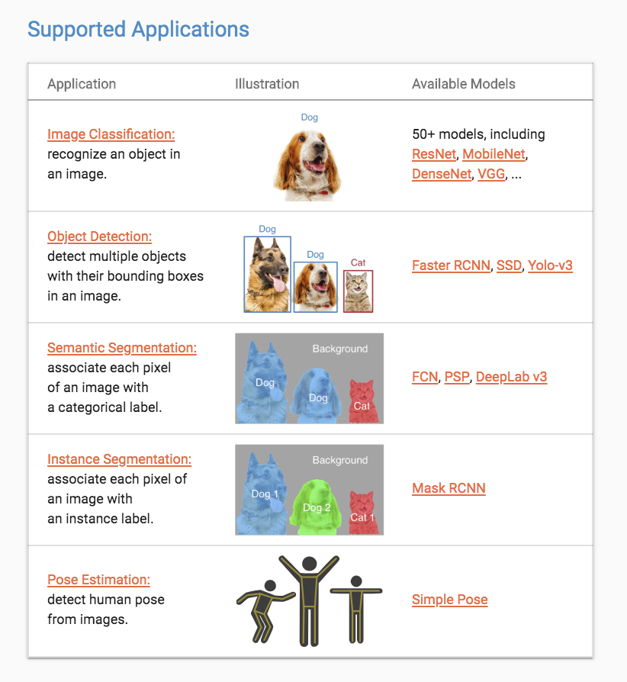
Algorithm variants : For instance, in Object Detection, different algorithms offer trade-offs between accuracy (mAP) and latency (fps)

Slide 15
Future labs
By feedback and demand! dylatong@amazon.com
Recognition:
Face Search
People Tracking
Textract solutions
More Amazon SageMaker use cases:
Segmentation, Pose Estimation, Similarity Search

Slide 16
Lab 1

Slide 17
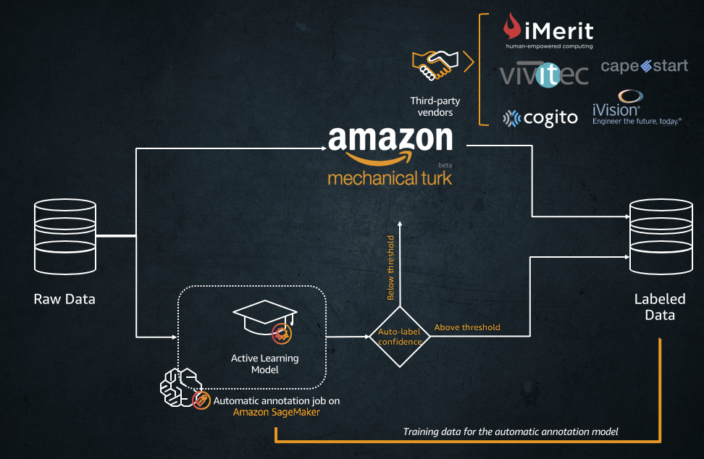
Manage a high-quality data set at scale
Launch a Notebook Instance.
Manage a private workforce.
Create an annotation job for Object Detection.
Generate a dataset and metadata compatible with Amazon SageMaker algorithms without further data wrangling!

Slide 18
Lab 2

Slide 19
Create a custom object detector with zero coding
SAGEMAKER OPTIMIZED ALGORITHMS
Configure a hyperparameter tuning job for an Object Detection Algorithm.
Train on GPU
Deploy a managed endpoint.
Test and visualize!
BlazingText Algorithm
DeepAR Forecasting Algorithm
Factorization Machines Algorithm
Image Classification Algorithm
IP Insights Algorithm
K-Means Algorithm
K-Nearest Neighbors (k-NN) Algorithm
Latent Dirichlet Allocation (LDA) Algorithm
Linear Learner Algorithm
Neural Topic Model (NTM) Algorithm
Object2Vec Algorithm
Object Detection Algorithm
Principal Component Analysis (PCA) Algorithm
Random Cut Forest (RCF) Algorithm
Semantic Segmentation Algorithm
Sequence-to-Sequence Algorithm
XGBoost Algorithm

Slide 20
Lab 3

Slide 21
Bring Your Own Script and automate the ML process
Examples
Training: Only modifications required is to set script certain parameters values from SageMaker container environment variables.
GluonCV YOLOv3 training script
PyTorch Siamese Network training script
Inference: requires overriding programmatic interface implementation.
GluonCV YOLOv3 model serving script
PyTorch Siamese Network model serving script
input_fn: request format pre-processing
model_fn: how to load the model
predict_fn: inference logic
output_fn: response format processing
Bring your own YoloV3 script on GluonCV
Prepare your data set and environment
Explore and prototype locally
Automate model tuning, and train
Deploy, test and visualize!

Slide 22
https://github.com/dylan-tong-aws/aws-cv-jumpstarter

Slide 23
aws.ai

Slide 24
Appendix

Slide 25
ML Solutions Lab
How we can help…
Brainstorming
Custom modeling
Training
Work side-by-side with Amazon experts
Machine Learning Training & Certification
Practical education on ML for new & experienced practitioners
Based on the same material used to train Amazon developers
Notes:
ML Solutions Lab is a program to help you accelerate your use of machine learning in products and processes.
The Amazon ML Solutions Lab pairs your team with Amazon machine learning experts to prepare data, build and train models, and put models into production.
It combines hands-on educational workshops with brainstorming sessions and advisory professional services to help you ‘work backwards’ from business challenges, and then go step-by-step through the process of developing machine learning-based solutions.
At the end of the program, you will be able to take what you have learned through the process and use it elsewhere in your organization to apply ML to business opportunities.
Toyota Research Institute, Johnson & Johnson and MLB used the ML Solutions Lab to kick start their ML projects.
https://aws.amazon.com/ml-solutions-lab/
Machine Learning Training and Certification courses introduce AWS customers and current and potential machine learning practitioners to the practical Amazon approach to machine learning (ML)
https://aws.amazon.com/training/learning-paths/machine-learning/

